Slide 1
Acceptance and Commitment Therapy in combination with Exposure and Ritual Prevention for Obsessive Compulsive Disorder via Videoconference
Elizabeth M. Goetter, Ph.D.^{1,2}, James D. Herbert¹, Ph.D., Evan M. Forman, Ph.D. ¹, Erica K. Yuen, Ph.D. ^{3,4}, Marina Gershkovich¹, Stephanie Goldstein¹
Drexel University
Massachusetts General Hospital
Medical University of South Carolina
Ralph H. Johnson VAMC

Slide 2
Obsessive Compulsive Disorder
OBSESSION
Increased
Anxiety
Reduced
Anxiety
COMPULSION
Notes:
2

Slide 3
Treating OCD: Current Situation
Research: Exposure and ritual prevention is the gold standard treatment for OCD.
Practice: Specialist providers are in short supply.
Gap: Most individuals with OCD do not receive adequate (if any) treatment.

Slide 4
Videoconference-mediated treatments show promise, but…
Research is preliminary
Videoconference technology can be expensive
OCD is difficulty to treat and typically relies on active, therapist involvement
Notes:
4

Slide 5
The Current Study: Aims
Is delivery of ERP through Skype feasible and acceptable?
Is remote delivery of ERP effective?
Is it advantageous to supplement ERP with acceptance and commitment therapy?

Slide 6
Participants
INCLUSION:
Adults with OCD
Living in eligible state
YBOCS ≥ 16
Access to Skype via computer and broadband connection
English fluency
EXCLUSION:
Comorbid psychotic disorder
Hoarding subtype
Acute suicide potential
Seeking additional therapy for OCD
Not on a stable medication regimen for prior 3 months

Slide 7
Informed Consent (n=23)
Diagnostic Interview (n=21)
Skype Test (n=15)
Allocated to ERP+ACT (n=8)
Allocated to ERP (n=7)
Completed Tx (n=5)
Completed Tx (n=5)
Phone Contact (n=148)
Completed F/U (n=4)
Completed F/U (n=5)

Slide 8
Participants
15 adults
87% female
Mean age=30.2
47% had a college degree
47% employed full-time
67% lived in nonmetropolitan areas,
40% lived >45 mins away from a specialist
47% were extremely or fairly familiar with Skype
67% had been in therapy before

Slide 9
Intervention
 | Standard ERP (n=8) | ERP + ACT (n=7)
# Sessions | 16 (90 min sessions) | 18 (90 min sessions)
Presenting a definition of OCD, psychoeducation | = | =
Rationale for Exposure | Habituation | Willingness in service of values
Primary goal of treatment (extending from theory) | Break link between (1) obsessions-anxiety; (2) rituals–anxiety reduction | Increased psychological flexibility
Time spent doing exposure | = | =
Out of session exposure | = | =
Phone check-ins | = | =
Supplemental coping strategies/support | Standard, therapist support, encouragement | Defusion, mindfulness, metaphors, etc.

Slide 10
Assessment Schedule
ERP
ERP+ACT
Pre
Pre
Mid (Session 9)
Mid (Session 8)
Post (Session 16)
Post (Session 18)
3 mo f/u
3 mo f/u
Clinical Evaluation + Self Report Questionnaires
administered at each Assessment Point

Slide 11
Data Analysis
Multiple imputation used for missing values
ITT and Completer Analyses were equivalent
Effect sizes are emphasized given small sample size
Formal between group analyses not conducted due to low power

Slide 12
Feasibility and Acceptability (both groups)
Attrition rate = 23%
82% mostly or completely satisfied with tx/therapist
91% reported receiving tx was very or fairly easy
Therapists reported tx very or fairly easy in 73% of cases
Homework adherence (M = 4.43) was comparable to in-person study (M = 5.17)
Most agreed (95% indicated > 70% agreement) that the videoconference environment was natural

Slide 13
Feasibility and Acceptability (both groups)
No technical problems for over half (57%) of all sessions
Severe or major technological problems were rare (3.5% of sessions)

Slide 14
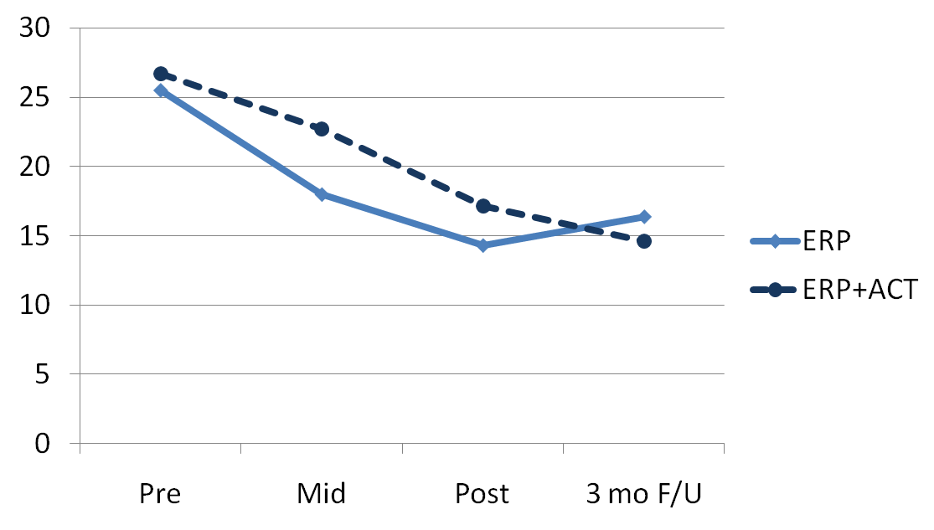
Treatment Outcome Trends by Group (YBOCS)

Slide 15
Treatment Outcome – Across All Participants
 | Pre Tx Mean | Post Tx Mean | t | p | Effect Size (d)
YBOCS | 26.15 | 13.23 | 6.51 | < .001 | 2.31
OCI-R | 31.46 | 11.85 | 4.46 | < .01 | 2.07
OBQ-44 | 180.54 | 106.31 | 4.58 | < .01 | 1.62
TAF | 24.62 | 10.92 | 2.74 | < .05 | 1.03
ROII-Emotions | 24.23 | 17.00 | 2.02 | = .067 | 0.89
ROII-Intensity | 29.23 | 15.85 | 3.61 | < .01 | 1.43
CGI-Severity | 5.00 | 2.85 | 6.06 | < .001 | 2.14
BDI | 15.08 | 10.31 | 1.17 | = .264 | 0.45
ASI | 28.31 | 12.15 | 3.95 | < .01 | 1.34
QLESQ | 51.51 | 66.23 | -2.12 | = .056 | 0.76
SDS | 21.46 | 9.69 | 4.04 | < .01 | 1.75
- 33% no longer met criteria for OCD at post-treatment
61% were rated “very much” or “much” improved

Slide 16
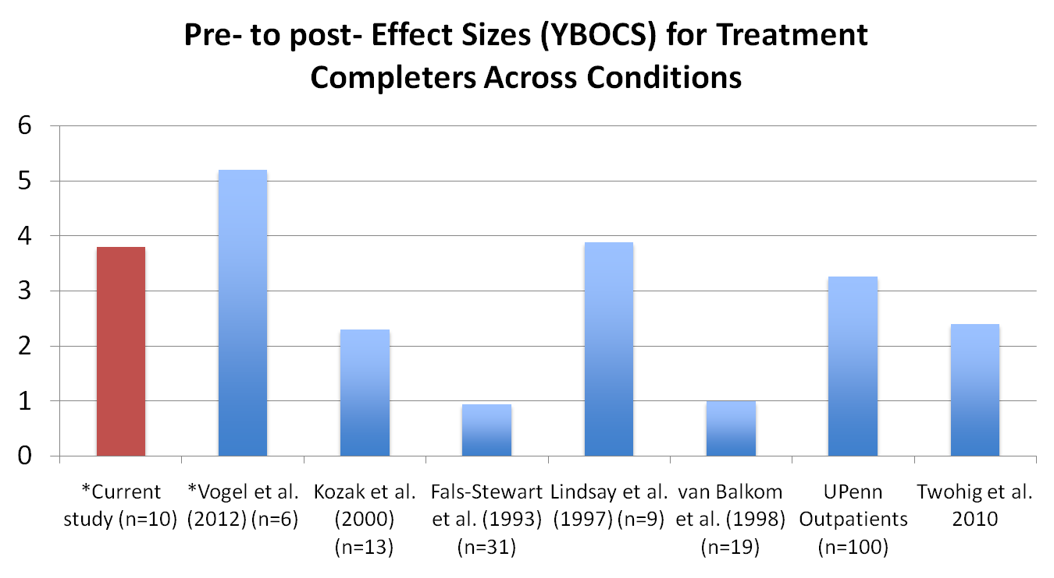
Effect Sizes
*Videoconference study

Slide 17
Change in ACT Process Variables – Across All Participants
 | Pre Tx Mean | Post Tx Mean | t | p | Effect Size (d)
AAQ-II | 46.60 | 33.31 | 2.94 | < .05 | 1.09
DDS | 24.92 | 29.00 | -2.16 | = .05 | 0.43
PHLMS-Acceptance | 24.16 | 30.31 | -2.55 | < .05 | 0.86
PHLMS-Awareness | 38.69 | 33.85 | 2.76 | < .05 | 0.73

Slide 18
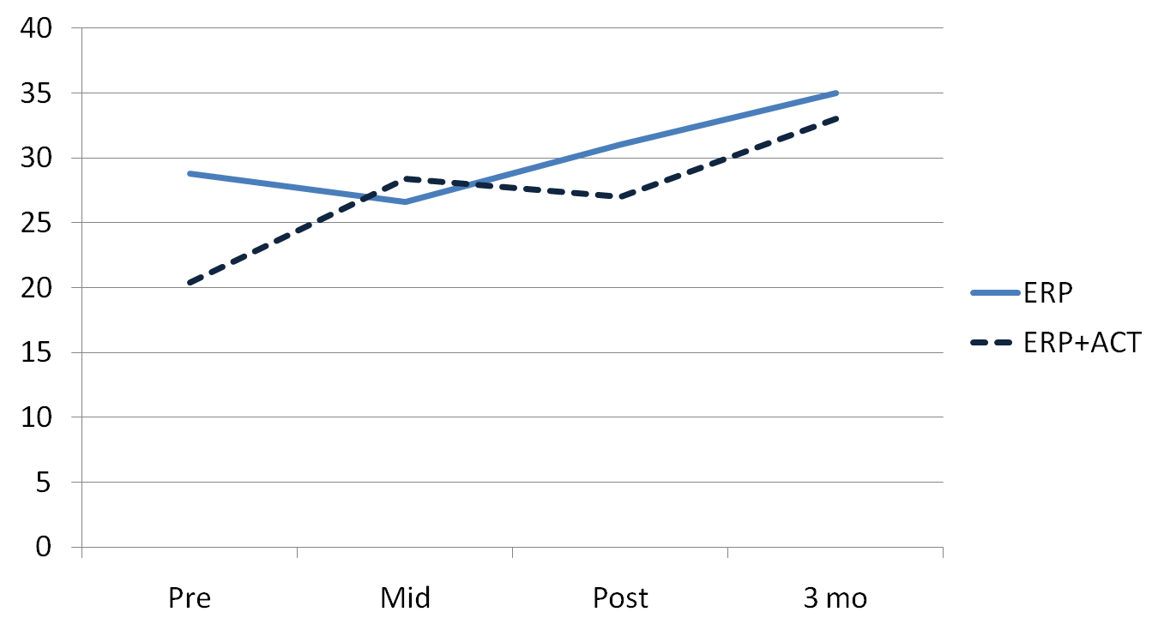
Defusion (DDS)

Slide 19
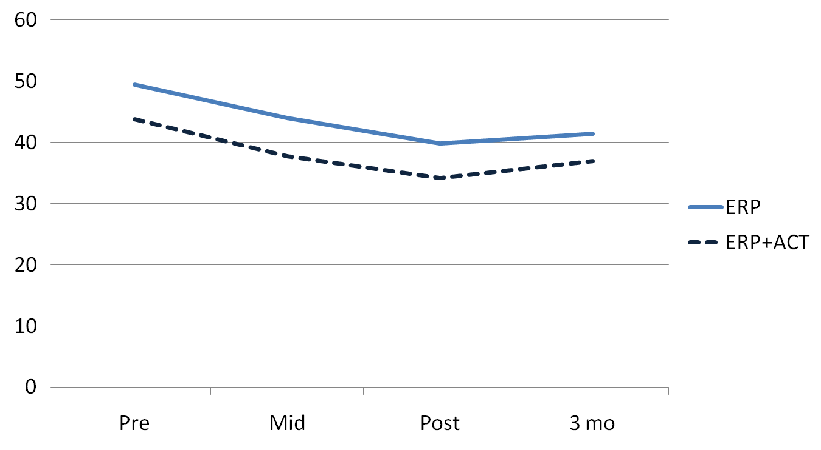
Psychological Inflexibility/Exp Avoidance (AAQ)

Slide 20
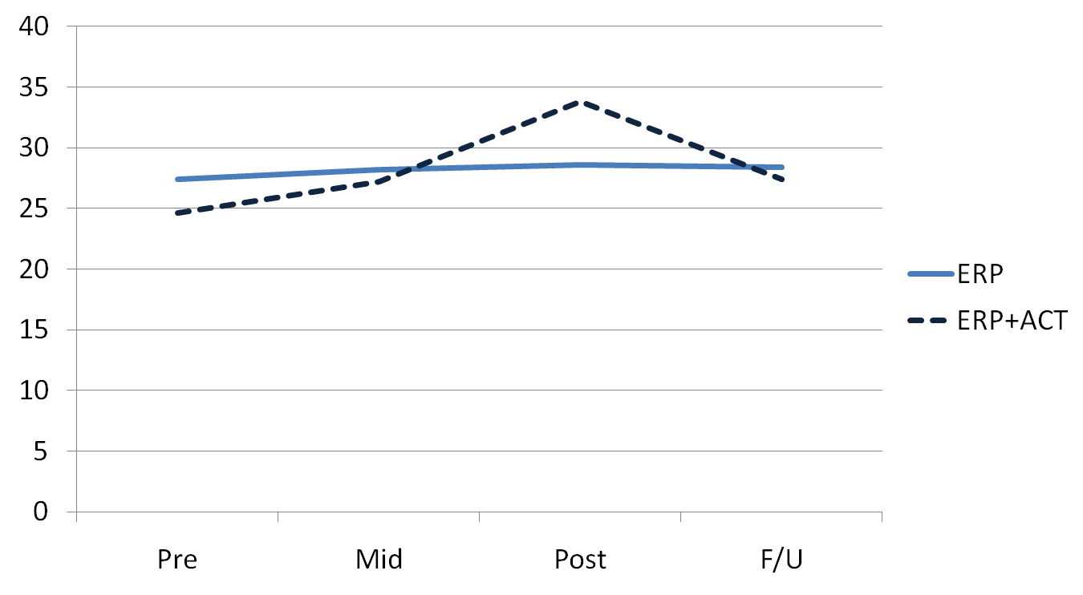
Mindful Acceptance (PHLMS)

Slide 21
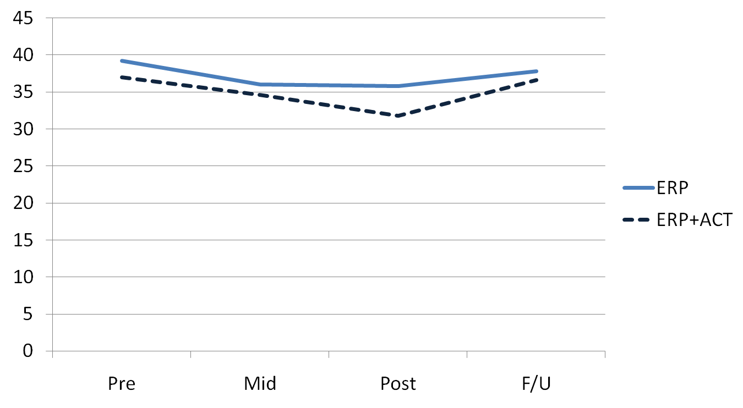
Mindful Awareness (PHLMS)

Slide 22
Correlations between Process Variables and OCD Symptoms – Across All Participants
 | YBOCS | OCI-R | OBQ-44
AAQ-II | .20 (p = .52) | .19 (p = .53) | .44 (p = .13)
DDS | -.35 (p = .23) | -.08 (p = .81) | -.30 (p = .31)
PHLMS-Acceptance | -.12 (p = .71) | -.44 (p = .13) | .30 (p = .33)
PHLMS-Awareness | -.05 (p = .87) | .01 (p = .98) | .21 (p = .49)

Slide 23
Advantages Challenges
Convenient and cost effective
Flexibility
Easy access to home and family
Technological difficulties
More difficult to assess subtleties
Reduced commitment?

Slide 24
Strengths and Limitations
Strengths
Largest videoconference trial of ERP to date (and larger than the only other 2 trials combined)
First known study of ACT+ERP for OCD via videoconference
Innovative methodology
Low cost burden for participants
Limitations
Small sample
No comparison group
Therapists had relatively limited experience
Potential recruitment bias

Slide 25
Recommendations
Mobile devices can aid as supplements
Model exposures as you would in face-to-face treatment
Minimize distractions
Provide tutorial in use of videoconference platform
Same ethical considerations apply

Slide 26
Future Directions
Randomized controlled trials (ACT vs. Standard ERP; Face-to-face vs. remote treatment settings)
Smartphone applications
Increasing adherence to treatment
Increasing access
21% of American adults do not use the Internet
34% of Americans do not have broadband Internet
Demographic disparities

Slide 27
Conclusions
ERP delivered through Skype is feasible and acceptable
Treatment was effective in reducing OCD symptoms and effect sizes were commensurate with in-person treatments
Defusion and psychological flexibility are relevant targets in the treatment of OCD

